Slide 1
Linear Filters

Slide 2
Blurring filters
More blurring implies widening the base and shortening the height of the spike further.
What does it look like?
Box filters are not best blurring filters but the easiest to implement.

Slide 3
Frequency domain representation

Slide 4
Time/Frequency or Primal/Dual
Lower energy in higher frequencies
Amplitude is more important
Phase information is better studied in time domain
x(t)
A(f)
P(f)
t
f
f

Slide 5
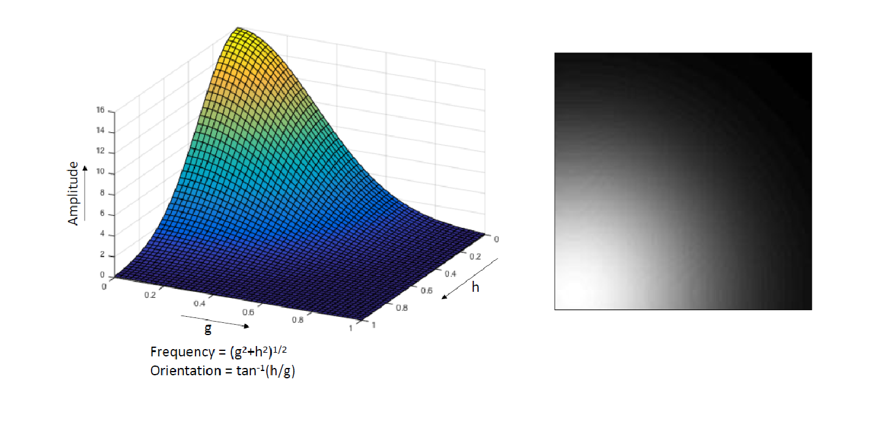
What happens in 2D?

Slide 6
Duality
Spatial Domain
Frequency Domain

Slide 7
Duality
Spatial Domain
Frequency Domain
Widening in one domain is narrowing in another and vice-versa.

Slide 8
Duality
Convolution of two functions in time/spatial domain is a multiplication in frequency domain
Vice Versa

Slide 9
All Pass Filter

Slide 10
Low Pass Filter
k[t]
K[f]
F
t
f
a(t)
X
A(f)
t

Slide 11
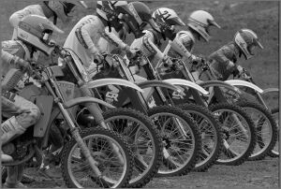
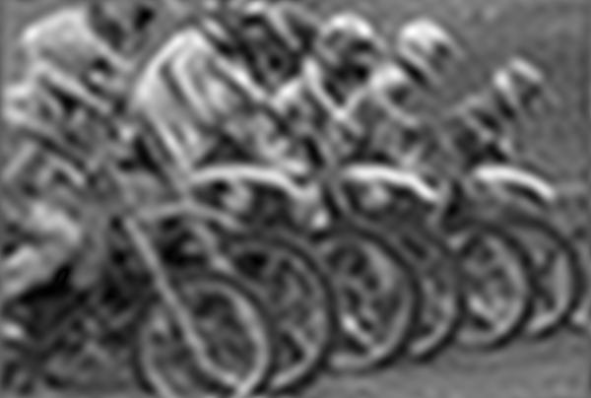
Low Pass Filtering
Box filter is known as low pass filter.

Slide 12
Box Filter
Effect of increasing the size of the box filter

Slide 13
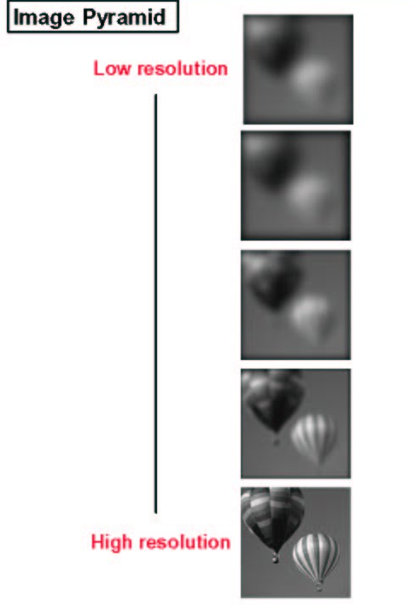
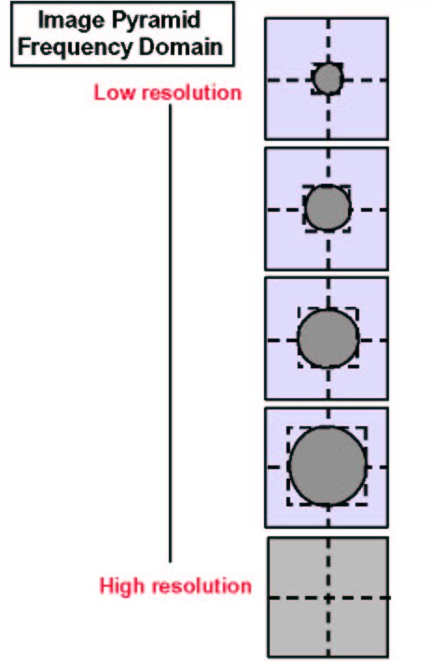
Gaussian Pyramid

Slide 14
Gaussian Pyramid

Slide 15
Box is not the only shape
Gaussian is a better shape
Any thing more smooth is better
x[t]
X[f]
F
t
f

Slide 16
Hierarchical Filtering
1/4
1/4
1/4
1/4
N x N
N/2 x N/2
N/4 x N/4
1 x 1

Slide 17
Issue of Sampling
As an image undergoes low pass filtering, its frequency content decreases
Minimum number of samples required to adequately sample the low pass filtered image is less.
Low pass filtered image can be at a smaller size than the original image.

Slide 18
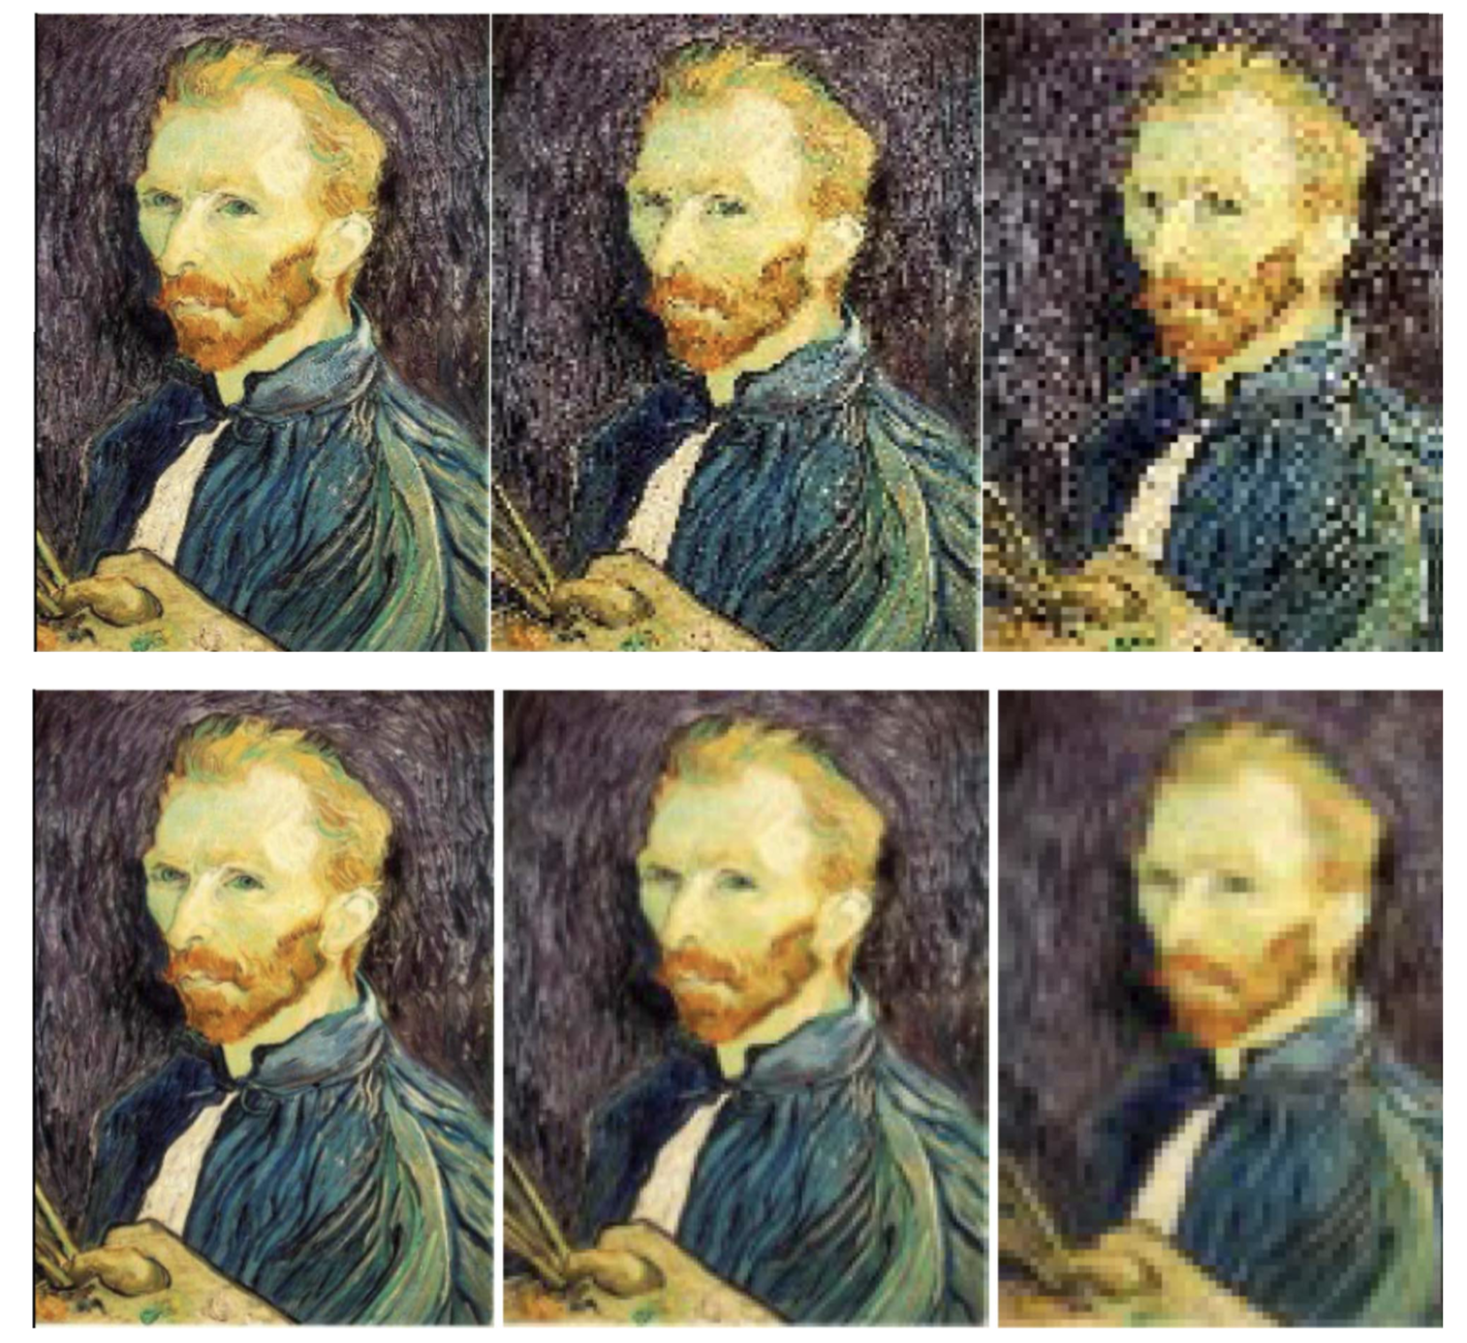
Subsampling
simple subsampling
pre-filtering and subsampling

Slide 19
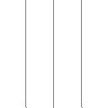
Aliasing Artifact
Filtering reduces frequency content.
Hence, lower sampling is sufficient.
Input (256 x 256)
Filtered (256 x 256)
ANTI-ALIASING
Insufficient sampling.
Hence, aliasing.
Subsampled(128 x 128)
Subsampled from filtered image(128 x 128)

Slide 20
High Pass Filter

Slide 21
High Pass Filter
Original Image
Low pass filtered
High pass filtered

Slide 22
Band-limited Images (Laplacian Pyramid)
B_{n-1}= G_{n-1}-G_{n-2}
f_{n-2}<f_{n-1}<f_{n}
B_{n}= G_{n}-G_{n-1}
f_{n-2}
f_{n-1}
f_{n}
G_{n-2}
G_{n-1}
G_{n}

Slide 23
Band-limited Images (Laplacian Pyramid)

Slide 24
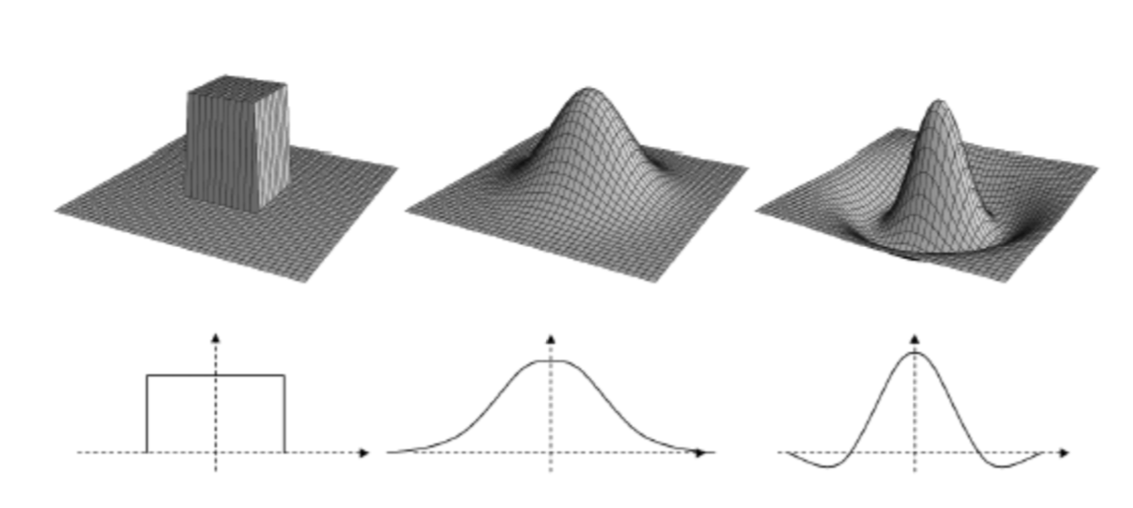
2D Filter Separability
Visualizing 2D filters from their 1D counter part
Box Filter
Gaussian Filter
High Pass Filter

Slide 25
2D Filter Separability

Slide 26
2D Filter Separability
Advantage
Separable filters can be implemented more efficiently
Convolving with h
Number of multiplications = 2pqN
Convolving with a and b
Number of multiplications = 2(p+q)N

